Slide 1
Chula Vista Police Department
Staffing Study
Notes:
This is a story of ongoing challenges as they relate to public safety staffing, which result in challenges delivering quality service to our community. The Police Department has been observing data related to these challenges for some time. But this is the first time the Police Department has been so plainly transparent with the Community, partially out of a desire not to stoke fear about the safety of our streets. The Police Department isn’t used to being so open and transparent about these concerns – it’s not an easy story to tell. But, as the Police Department has watched performance and service metrics continue to decline, this is a story that needed to be told so that the community can work together to find long-term solutions.

Slide 2
City of Chula Vista
Community Facts
52 square miles
Population 267,000 (second-largest city in the County of San Diego)
Regional leader in conservation, “Smart City” technologies
One of the safest cities in the nation
Among the best schools in the county and state
Notes:
Community Facts
52 square miles
Current population (est.) 267,000 – second-largest city in the County.
Regional leader in efficiency and conservation
Smart City
One of the safest cities in the nation
In 2015, ranked the 10th safest city in the country with a population over 200,000 (Law Street Media)

Slide 3
City of Chula Vista
Community Population
Current Population (2017): 267,971
Projected Population (2035): 350,000
Historically one of the fastest-growing cities in the nation
Second-largest city in the County of San Diego
Notes:
City Population (Real, and Projected)
Current Population (2017): 267,971
Projected Population (2035): 350,000
Historically one of the fastest-growing cities in the nation
Second Largest City in County of San Diego
52 Square Miles of Land

Slide 4
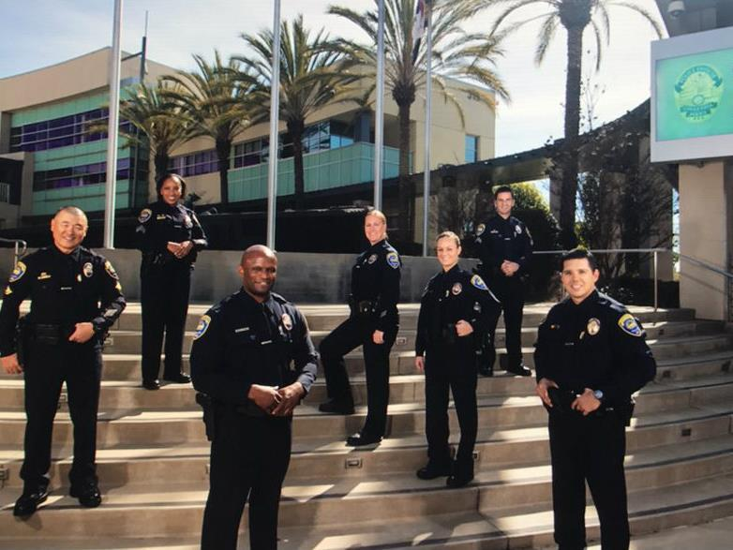
City of Chula Vista
City Governance
16 city departments for government operations
Like most cities, public safety are the largest departments
Like many cities, challenged to sufficiently fund Public Safety
In 2017, City Council directed staff to develop options to address chronically-understaffed Public Safety
Staff worked with Public Safety community advisory committee to review and recommend options
Notes:
City is comprised of 16 departments
Public Safety makes up largest portion of city budget, but consistently challenged to sufficiently fund
2017, City Council directed staff to report on Public Safety staffing.
After receiving report, City Council declared the Public Safety Staffing situation a crisis.
Subsequently directed to develop options to address chronic underfunding.
Public Safety Advisory Committee (PSAC) reviewed and recommended options.
Staff presented to City Council, who voted to put a measure on the ballot and give the community a voting choice.

Slide 5
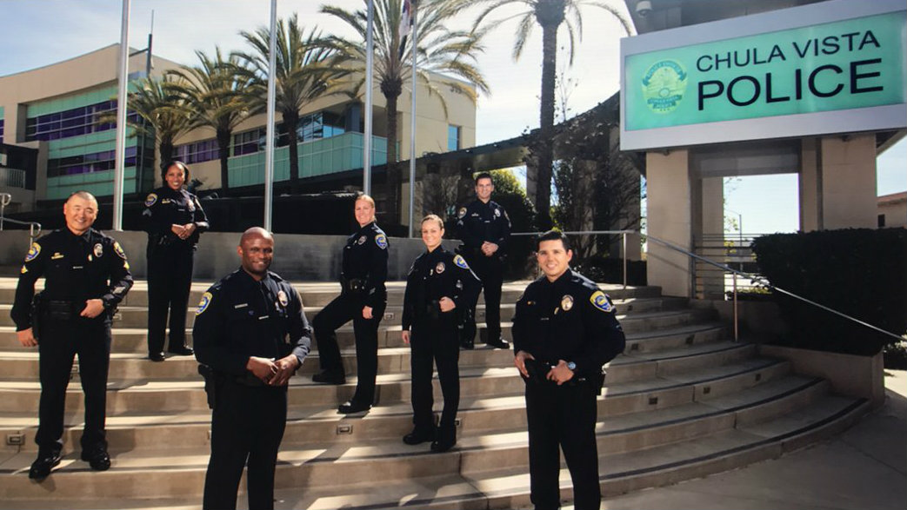
Chula Vista P.D. at-a-glance
323.5 Total Personnel
232 Sworn
91.5 Civilian
Four Divisions
Patrol Operations
Investigations
Support Operations
Administration
Notes:
Overall Staffing
232 sworn personnel
91.5 civilian personnel
4 Divisions – Patrol, Investigations, Support, Admin. Services (see next slide)

Slide 6
Police Department Staffing by Division
Most employees are assigned to Patrol (uniformed officers seen on the street).
Notes:
Fast Facts:
4 Divisions – Patrol, Investigations, Support, Admin. Services
Largest division = Patrol w/ 174 employees
Staffing by Division
Patrol = 174 employees
Investigations = 65.5 employees
Support Operations = 63 employees
Administrative Services = 25 employees

Slide 7
Sworn Staffing by Division
Nearly all sworn staff (police officers) are assigned to enforcement-related functions such as patrol, detectives, and investigations.
Notes:
Sworn Staffing Only, by Division
Patrol = 174 employees
Investigations = 65.5 employees
Support Operations = 63 employees
Community Patrol
6 teams to cover 24/7
Average 13-17 officers per team (when fully staffed and present)
Note: 1989 roster, minimums were 9 (population was 135k)

Slide 8
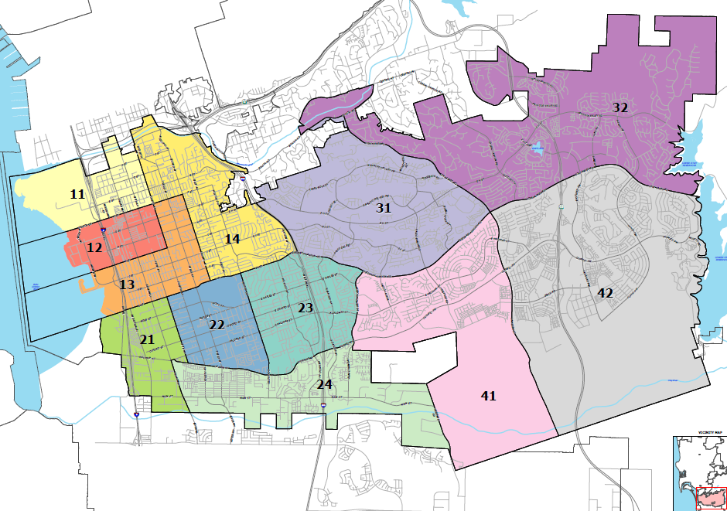
Police Beats
Patrol officers are assigned to beats (usually 1 per beat).
Notes:
Police Headquarters located on the west side of the city
No sub-station(s) at this time
Organized into 4 sectors
12 Police Beats
Usually, 1 officer per beat

Slide 9
First-Line Services, Full Staffing
Daily staffing averages, when fully staffed.
PATROL
111 Officers + 12 Agents
17 officers avg. on-duty *
911 DISPATCH
21 Dispatchers + 5 Sup’s
5-6 avg. on-duty *
3-4 to answer 911 calls *
* Averages assume full staffing with no vacancies, no absences, etc.
Notes:
This slide assumes fully staffed, with no vacancies and no absences.
1. Community Patrol (1st Responders)
111 Police Officers + 12 Police Agents
Average 17 officers on duty at any time*
2. Communications Center (911 and Police Dispatch)
21 Dispatchers + 5 Supervisors
Average 5-6 dispatchers on duty at any time
As a result, 3-4 to answer 911 and other calls
We have not been fully staffed for many years. We usually work closer to required minimums, according to internal policies.

Slide 10
First-Line Services, Required Staff
Realistic staffing, considering vacancies & absences.
PATROL
12-13 officers avg. on-duty at any time *
911 DISPATCH
4-5 avg. on-duty *
2-3 to answer 911 calls *
1 during graveyard shift *
* Averages assume minimum staffing in accordance with minimum staffing policies.
Notes:
This slide assumes minimum staffing due to sick leave, injuries, vacancies, etc.
1. Community Patrol (1st Responders)
106 “beat officers”
Average 12-13 officers on duty at any time*
Less than 1 per Beat
2. Communications Center (911 and Police Dispatch – a.k.a. “First, first responders”)
Average 4-5 dispatchers on duty at any time
As a result, 2-3 to answer 911 and other calls
1 to answer 911 calls during graveyard shift

Slide 11
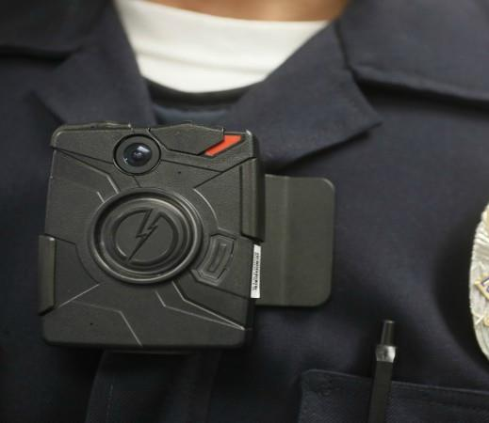
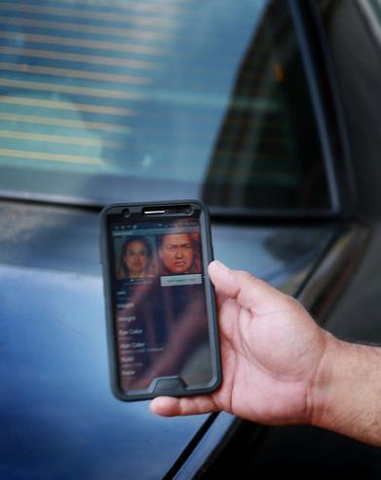
CVPD Strengths Today
ONE OF THE SAFEST CITIES
LEAN OPERATIONS
TECHNOLOGY & INNOVATION
EFFICIENCY
Notes:
Strengths:
Very Safe Community
Still considered a very safe community - In 2015, ranked the 10th safest city in the country with a population over 200,000 (Law Street Media)
In 2016, ranked 9th safest out of the 18 cities in San Diego County
Strong Community Ties
Strong Community Policing philosophy, deeply engrained in culture
Maintains strong ties with our community and its institutions and enjoys a positive reputation
Lean organization
One of the leanest Police Departments of its size, as you’ll see in future slides.
Lean workforce – streamlined processes and workflow with an emphasis on customer service and efficiency
Great use of Technology and Innovation to increase efficiency
Major technological advances in recent years – recognized as a “Smart City”
Measure P Benefits for Infrastructure (vehicles, technology modernization, etc.)
The success of Measure P has allowed CVPD to purchase critical technology and equipment to support operations

Slide 12
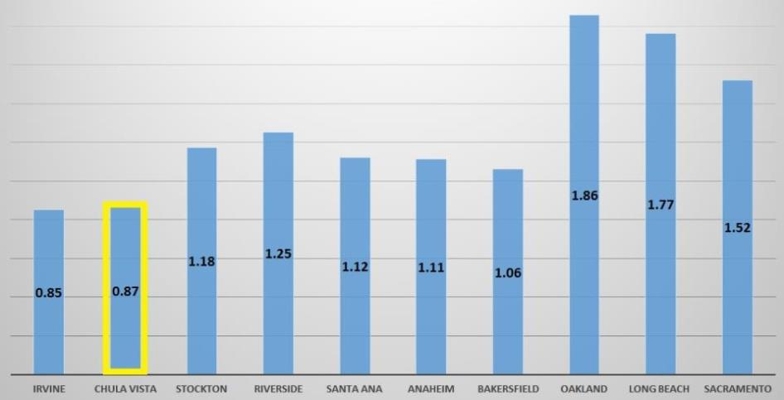
CVPD Gaps and Challenges
STAFFING:
STATEWIDE COMPARISON
DECLINING
STAFFING
INCREASING
WORKLOAD
LIMITED
DETECTION
RESPONSE
TIMES
Notes:
Chronically low staffing, affecting quality and quantity of service
Less than we want, and less than we believe the community deserves and needs
Sworn and civilian staffing levels have impacted crime fighting, quality of life and customer service in Chula Vista
Traffic Division
School Resource Officers
Investigations Division
Community Policing Unit
Increasing Population = Increasing Workload
Continued growth projected, until buildout in 2035 at 350,000
Projected growth will continue to pose as the Department is faced with new communities in addition to new commercial, university and tourist districts
Limited investigations and follow-up on crimes
CVPD’s capacity to follow up and thoroughly investigate crime in Chula Vista has been significantly diminished since the Great Recession
Not meeting response times to Emergency calls
CVPD is no longer able to meet GMOC threshold standards set in 1986 to uphold Chula Vista’s quality of life standards. The GMOC standards were revised and updated in 2014 but the department still falls short.
Haven’t met GMOC thresholds for 19 years (Pri. 1 and Pri. 2 calls combined)

Slide 13
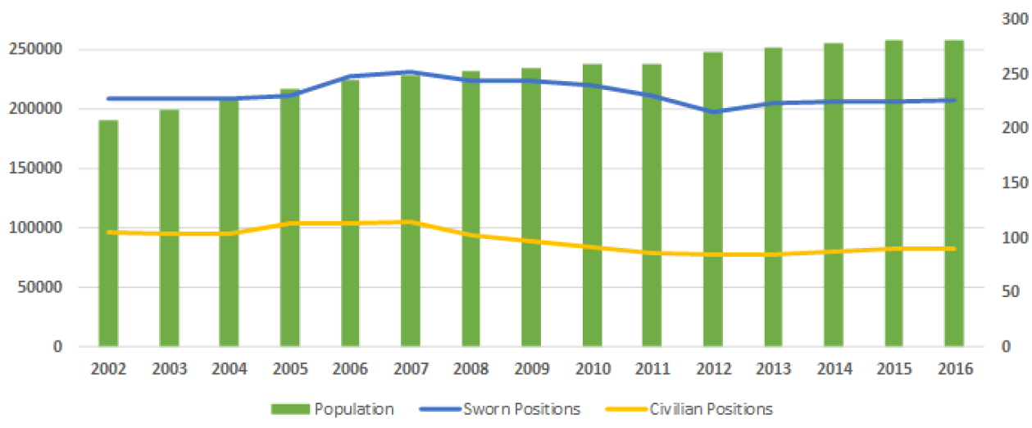
Great Recession Takes Its Toll
City Population vs. Police Staffing
1.12
.87
Officers per 1,000 citizens
Notes:
Green bars = Population rising
Blue line = Sworn staffing (decreased)
2007: 1.12 per Capita (259 Officers)
2017: 0.87 per Capita (232 Officers, with a much larger population)
Gold line = Professional/support staffing
2007 vs. 2017
25% larger population with 12% fewer officers
11 fewer detectives
9 fewer officers
23 fewer civilian support staff
Officer per 1,000 citizens (explained)
2007 = 259 Sworn Officers. (Officers per 1,000 population ratio: 1.12)
2017 = 232 Sworn Officers. (Officers per 1,000 population ratio: 0.87)
If we had stayed at the same ratio as our peak, today we’d have about 300 sworn positions (nearly 70 additional officers)
This is equivalent to 68 officers or 29% more sworn staff)

Slide 14
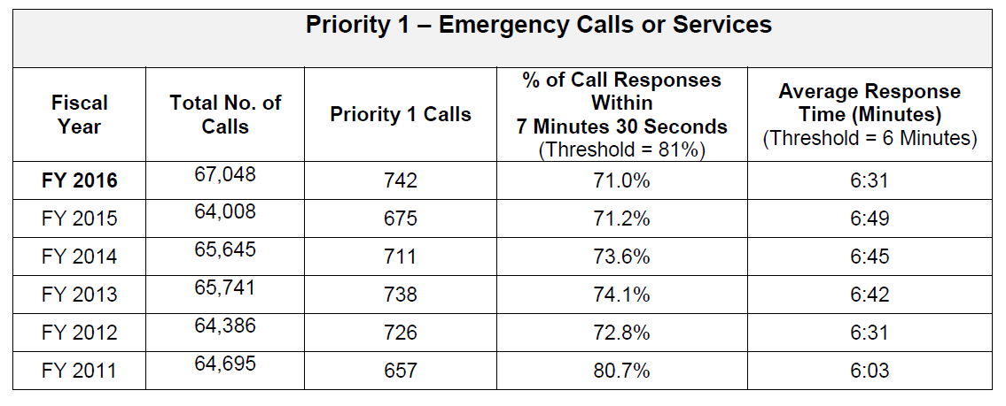
Response Times, GMOC Thresholds
Priority 1’s (Life & Death Emergencies)
In 2017, CVPD failed to meet the GMOC Priority 1 threshold for the fourth year in a row.
Notes:
Priority 1 Response Times
Life and Death Emergencies
GMOC Threshold = 6:00 minutes
Haven’t met in 4 years

Slide 15
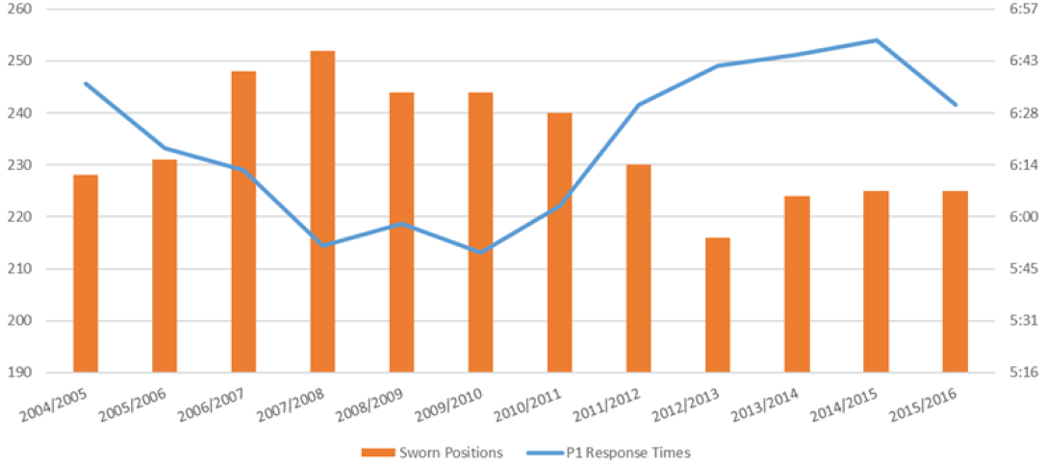
Staffing vs. Response Times
Priority 1’s (Life & Death Emergencies)
1.12
.87
GMOC
GOAL
Officers per 1,000 citizens
Response Time Goal (6 min, set by Growth Management Oversight Committee)
CVPD’s hasn’t met response time goals for Priority 1 calls in 4 years.
Notes:
Priority 1 Response Times
Life and Death Emergencies
GMOC Threshold = 6:00 minutes
Haven’t met in 4 years

Slide 16
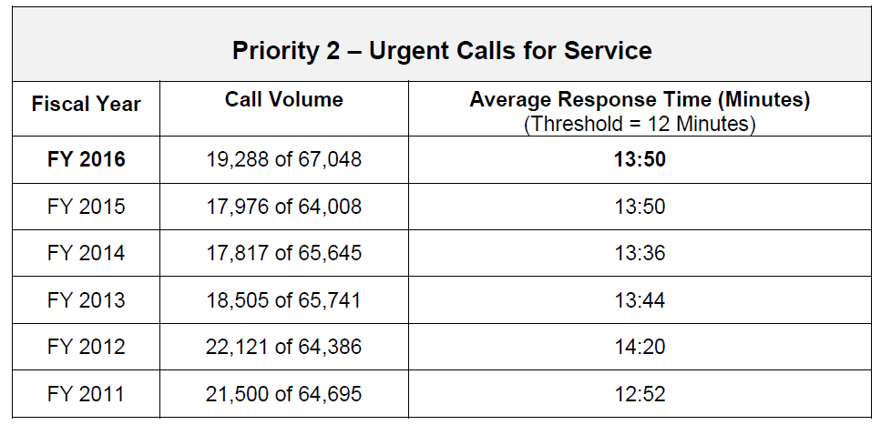
Response Times, GMOC Thresholds
Priority 2’s (Other In-Progress Emergencies)
In 2017, CVPD failed to meet the GMOC Priority 2 threshold for the 19th year in a row.
Notes:
Priority 2 Response Times
Other Emergencies and Crimes In Progress
GMOC Threshold = 8.5 to 12 minutes (changed in 2014)
Haven’t met in 19 years

Slide 17
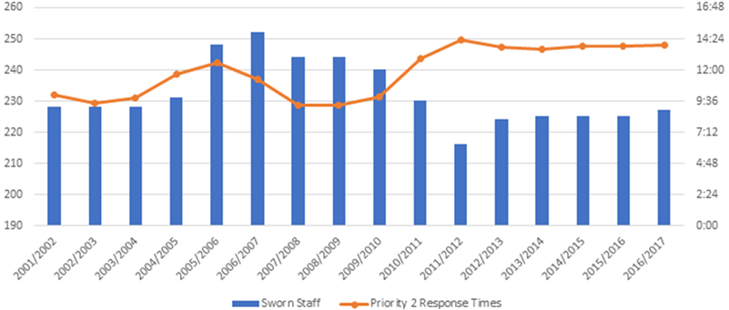
Staffing vs. Response Times
Priority 2’s (Other In-Progress Emergencies)
1.12
GMOC
GOAL
.87
Officers per 1,000 citizens
Response Time Goal 8.5-12 min (changed in 2014) set by Growth Management Oversight Committee
CVPD’s hasn’t met response time goals for Priority 2 calls in 19 years.
Notes:
Priority 2 Response Times
Other Emergencies and Crimes In Progress
GMOC Threshold = 8.5 to 12 minutes (changed in 2014)
Haven’t met in 19 years

Slide 18
911 Calls: Impact of Cell Phones
911 Calls per Month
CVPD’s receives about 300,000 telephone calls per year, and about 8,000 911 calls per month. This number has doubled in the last 10 years.
Notes:
Impact of Cell Phones on 911 Call Volume
Less than 22% of these calls are transferred to Fire/Medical in 2017 (17,409 our of 80,543 911 calls)
911 calls doubled in 10-year period 2005-2015
Over 300,000 telephone calls
About 8,000 911 calls (double from 2005)
Source: State of California Office of Emergency Services, Ecats

Slide 19
Reactive vs. Proactive Policing – Patrol
Since 2008, Proactive Policing is on the decline.
Officer proactivity crucial for crime fighting.
Arrest rates are often tied to officer proactivity.
CHULA VISTA PUBLIC SAFETY
Notes:
Proactive vs. Reactive Policing (explained)
Officer initiated activities crucial for crime fighting
Stopping crime before it happens vs. merely responding after-the-fact
Arrest rates often related to officer initiated activities
Since 2008, proactive policing on the decline:
Officer Initiated Incidents – 53%
Felony Arrests – 41%
Misdemeanor Arrests – 26.5%

Slide 20
Reactive vs. Proactive Policing – Traffic
Between 2008 - 2016
Traffic citations on the decline.
Collisions and injuries are increasing.
CHULA VISTA PUBLIC SAFETY
Notes:
Between 2008-2016
49% fewer traffic citations
10% more Collisions
28% more Deaths and Injuries
Variables:
Traffic Division cuts
City growth
Time for Office Proactivity

Slide 21
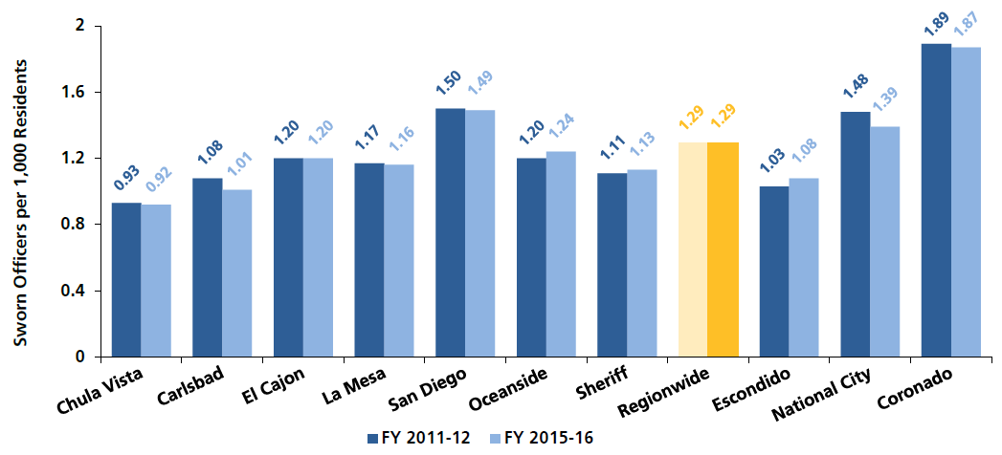
Regional Staffing Comparisons
Officers per 1,000 population
.87
Note: Table produced in 2015-16. CVPD’s current ratio is 0.87.
CVPD would need to add 112 officers to match Countywide average.
CVPD would need to add 40 officers to “tie” for lowest ratio in the county.
CHULA VISTA PUBLIC SAFETY
Notes:
Current Sworn: 232
Current Population: 267,000
Chart (explained)
Chart shows 2015-16
Currently, 0.87 Officers per 1,000 population
CVPD would need to add 112 officers immediately to meet the county average (1.29)
CVPD would need to add 40 officers immediately to tie for dead last (Carlsbad at 1.01)
Source: SANDAG Law Enforcement Allocations Report

Slide 22
Statewide Staffing Comparisons
Officers per 1,000 population
Comparison with similar-sized cities in California.
CHULA VISTA PUBLIC SAFETY
Notes:
Chart (explained)
Nearly lowest of comparable cities
Except Irvine, the “Unicorn of California”
Est. 7th richest city in the U.S. (Nearly double our median income)
Significant industry
Lower Crime: 2014 Crime Rates
Violent crimes: 120 (vs. 612)
Viol. crime per capita: 0.49 (vs. 2.35)
Prop. Crimes: 3,045 (vs. 4,524)

Slide 23
Policing Public Schools
The School Resource Officer (SRO) unit provides service to approximately 61 public schools in the city of Chula Vista:
Total Students: 51,140
11 High Schools (16,684 students)
7 Middle Schools (7,231 students)
44 Elementary Schools (27,225 students)
Total School Resource Officers: 8
4 Assigned to High Schools
4 Assigned to Elementary Schools.
CHULA VISTA PUBLIC SAFETY

Slide 24
Regional Budget Comparisons
Chula Vista spends $199 per capita on Law Enforcement services
26.5% less than the next lowest, Escondido which spends $271 per capita
40% less than the Regional average of $332 per capita
CVPD budget would need to budget $72.5M to be tied for last in the county in per capita funding ($19M gap)
Chula Vista’s 2007 per capita spending in 2007 was $240 or 17% higher than the current budget
CHULA VISTA PUBLIC SAFETY
Notes:
Source: SANDAG Law Enforcement Allocations Report

Slide 25
Regional Budget Comparisons
City spending on police services per 1,000 population
REGIONAL AVERAGE
CORONADO
NATIONAL CITY
OCEANSIDE
SAN DIEGO
CARLSBAD
LA MESA
EL CAJON
ESCONDIDO
CHULA VISTA
CVPD’s current budget is 17% less than it was in 2007.
CVPD would need to add about $19M to “tie” for lowest ratio in the county.
CHULA VISTA PUBLIC SAFETY
Notes:
Chula Vista Police budget smallest per Capita among the region
Chula Vista spends $199 per capita on Law Enforcement services
26.5% less than the next lowest, Escondido which spends $271 per capita
40% less than the Regional average of $332 per capita
Current budget is 17% less than it was in 2007
Note, this is an indication of our lean staffing and efficiency
May also counter arguments about payroll and benefit cost increases since 2007
CVPD budget would need to add about $19M to be tied for dead last in the county in per capita funding (Escondido)
Comparison Populations
Chula Vista (Pop: 267,917) 31%
Oceanside (Pop: 176,461) 41%
Escondido (Pop: 151,492) 41%
Source: SANDAG Law Enforcement Allocations Report

Slide 26
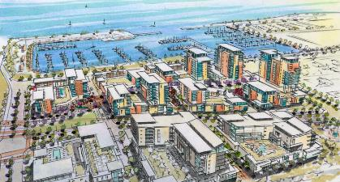
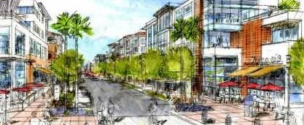
Policing a Vibrant Community
Strengths and Opportunities
Rapid Growth
Future Bayfront
Millennia Project
University Park and Innovation District
CHULA VISTA PUBLIC SAFETY
Notes:
Chula Vista continues to grow
2035 Buildout population will be about 350,000
Major Bayfront development will result in a tourism district and increased service demand
Millennia and Otay Ranch Projects bring density, students and traffic
Future University site will increase traffic and service demands

Slide 27
Policing a Vibrant Community
Future Challenges
Rapid Growth
Technical Crime
Tourism Impacts
New Types of Community Problems
Legalization & regulation
Impaired Driving
Increasing Homelessness
Human Trafficking
Evolving
Drug Crimes
Need for More Outreach
School/Student Safety
Notes:
As Chula Vista grows, CVPD will continue to struggle to provide adequate police service without a major influx of personnel both on the sworn and civilian level
Continued growth projected, until buildout in 2035 at 350,000
Policing a major new tourist district
New commercial, university and tourist districts may result in new types of crimes, and criminal opportunistic
Modern Crime Problems require more time and complexity to investigate and prosecute
Evolution of combatting cyber crime and the evolution of police technology
Other growing and emerging community problems
Marijuana legalization: Regulating legal and illegal marijuana dispensaries
Traffic safety and enforcement to include drugged/drunk driving
Growing homeless population – enforcement and support resources
Combatting human trafficking
Ever changing drugs (spice, etc.) impacting our youth
Need for expanded engagement on social media, community relations and outreach (expanding and improving community outreach and crime prevention efforts)
Providing adequate resources to more students and more schools

Slide 28
Police Critical Needs – Staffing
New Positions Needed to “Catch Up” to Population
Increase 43 sworn positions in the following areas:
Community Patrol (24)
Homeless Outreach Team (4)
Traffic Enforcement Officers (4)
School Resource Officer Unit (4)
Investigations (7)
Increase 19 civilian positions in the following areas:
Dispatch Center (12)
Community Patrol (3)
Police Technology (1)
Detention Facility (1)
Background Investigations (2)
CHULA VISTA PUBLIC SAFETY
Notes:
“Catch Up” Phase, described in City Council
43 sworn
19 civilian
This is only to catch us up, and doesn’t account for future growth.

Slide 29
Police Critical Needs – Staffing
New Positions Needed to “Catch Up” to Population
43 Sworn Positions
27 Officers
10 Agents
6 Sergeants
19 Civilian Positions
11 911 Dispatchers
3 Community Svc Officers
5 Miscellaneous
Note: This doesn’t account for future population growth.
CHULA VISTA PUBLIC SAFETY
Notes:
“Catch Up” Phase, described in City Council
43 sworn
19 civilian
This is only to catch us up, and doesn’t account for future growth.

Slide 30
Police Critical Needs – Costs
New Resources to “Catch Up” to Population (PD only)
43 Sworn Positions
19 Civilian Positions
$12.7M
ANNUALLY
FOR PD ONLY
CHULA VISTA PUBLIC SAFETY
Notes:
Cost for “Catch Up” starts at $12.7M annually (for police alone)
FD Costs for Critical Needs adds $27M annually to this figure
Source: City of Chula Vista Department of Finance

Slide 31
Potential Revenue Options
Revenue Options Considered
Evaluated by Public Safety Advisory Committee (PSAC) and City Council
Option | Considerations | Estimated Revenue
Sales Tax | General tax (50% + 1) vs Special tax (Requires 2/3) Immediate Impact Susceptible to declines during recession | Up to $16M per year.
Parcel Tax | Requires 2/3 votes Immediate Impact | $100,000 for every $1 added.
Public Safety Community Facilities District | Easier approval process Only applicable to new development or redevelopment Delayed Impact | Unknown. No upper limit.
Fee Increases for Public Safety Services | Set fees based on cost of service provided Delayed Impact | Unknown.
Transient Occupancy Tax | Paid by tourists Currently 10%, not recommended to go above 12% Delayed Impact | About $800K per 2% increase.
Land Use, Revitalization, etc. | Very Slow Impact | Unknown.
CHULA VISTA PUBLIC SAFETY
Notes:
Revenue options considered by community Public Safety Advisory Committee, by City Staff, and finally by City Council. Of considered options, Sales Tax was the only one with enough immediate impact to help resolve the crisis. But even sales tax doesn’t cover all needs
Source: City of Chula Vista Public Safety Advisory Committee (PSAC)

Slide 32
Two-Phase Staffing Plan
Est. revenue from ½-cent Sales Tax
Positions | Phase I | Phase II | Total
Peace Officers | 16 | 11 | 27
Police Agents | 8 | 2 | 10
Police Sergeants | 5 | 1 | 6
Total Sworn | 29 | 14 | 43
Civilian Background Investigator | 2 | − | 2
Community Services Officer | 2 | 1 | 3
Detention Facilities Manager | 1 | − | 1
Police Comm Systems Manager | 1 | − | 1
Police Dispatcher | 7 | 4 | 11
Sr. Police Technology Specialist | 1 | − | 1
Total Non-Sworn | 14 | 5 | 19
Total Police Personnel | 43 | 19 | 62
CHULA VISTA PUBLIC SAFETY
Notes:
Staffing plan split into two phases:
Phase I (from est. Sales Tax revenue)
29 Sworn
14 Civilian
Phase II (source TBD)
14 Sworn
5 Civilian

Slide 33
Phase I Staffing Plan
New Positions from Sales Tax Revenue ($8M)
29 Sworn Positions
16 Officers
8 Agents
5 Sergeants
14 Civilian Positions
7 911 Dispatchers
2 Community Svc Officers
5 Miscellaneous
CHULA VISTA PUBLIC SAFETY
Notes:
Projected positions from Sales Tax Revenue
29 Sworn
14 Civilian

Slide 34
First-Line Service Enhancements
Phase I Expected Staffing Enhancements
SWORN STAFF
16 more officers on patrol
55% more Traffic Safety Officers
50% more School Officers
CIVILIAN STAFF
26% more 911 Dispatchers
33% more Community Service Officers
Notes:
Significant Benefits
Enhanced patrols by adding 16 sworn positions
50% increase in SRO (5 sworn positions)
55% increase in Traffic Safety (5 sworn positions)
26% increase in Dispatch and 911 (7 dispatchers)
Reductions to Critical Needs Staffing:
4 less in Patrol
4 less in 911 Dispatch
No expanded HOT Team
No expanded Police Regulated License enforcement
Cannabis
Alcohol licenses
Massage parlors
Prostitution and human trafficking, etc.

Slide 35
Phase II Staffing Plan
New Positions from Phase II
14 Sworn Positions
11 Officers
2 Agents
1 Sergeant
5 Civilian Positions
4 911 Dispatchers
1 Community Svc Officer
CHULA VISTA PUBLIC SAFETY
Notes:
Phase II Staffing Plan
14 Sworn
5 Civilian

Slide 36
Phase II Service Enhancements
Phase II Desired Staffing Enhancements
SWORN STAFF
200% Homeless Outreach
Double capacity for police regulated businesses
Marijuana, Massage, Alcohol, Tobacco, etc.
CIVILIAN STAFF
Meet critical needs for 911 Dispatchers
Enhanced services for community service
Notes:
Reductions to Critical Needs Staffing still need to be addressed in Phase II:
4 less in Patrol
4 less in 911 Dispatch
No expanded HOT Team
No expanded Police Regulated License enforcement
Cannabis
Alcohol licenses
Massage parlors
Prostitution and human trafficking, etc.

Slide 37
Phase II Revenue Plan
Under Evaluation
Notes:
Phase II Revenue Plans are currently being considered, but yet to be determined.

Slide 38
Desired Public Safety Outcomes
The top ten desired public safety service outcomes of this report are basic:
Improve Priority 1 and Priority 2 response times to consistently meet and surpass GMOC Thresholds
Expand the Homeless Outreach Team to help address the City’s most pressing social needs
Improve Community Patrol staffing to provide for 40% pro-active time. This will result in an organization that is pro-active vs. reactive to crime and disorder trends
Improve Communications Center staffing and operations to improve first line contact and service processing with the public
Improve Investigative capacity and follow up in all major investigative units to maximize successful case resolution and provide better customer service to victims
CHULA VISTA PUBLIC SAFETY
Notes:
Emergency response times
Expand homeless capability (if possible)
Improve Patrol capability
Improve 911 Dispatch capability
Improve Investigative capability

Slide 39
Desired Public Safety Outcomes
Improve the Traffic Division’s operational footprint to pro-actively respond to traffic related problems and reduce traffic related deaths and injuries
Significantly expand the School Resource Officer Unit to more adequately serve the needs of growing school districts and the youth population of Chula Vista
Expand use of technology to streamline operations and support intelligence led policing practices
Expand the Department’s Community Policing unit and community outreach efforts to foster stronger community ties
Provide for the expansion of services to the eastern section of the City by staffing a storefront or small substation with full time staff during regular business hours. A similar storefront would be planned for the Bayfront tourist district to support a reconstituted bike team to patrol the tourist district
CHULA VISTA PUBLIC SAFETY
Notes:
Improve proactive Traffic Safety enforcement
Expand services to schools and students
Expand community policing
Enhance services to eastern city

Slide 40
Thank You
For more information, visit:
www.chulavistaca.gov/publicsafety
Notes:
Contact info

Slide 41
End of presentation
Notes:
END OF PRESENTATION

