Slide 1
City of Chula Vista Public Safety Critical Needs First Friday Breakfast March 2, 2018

Slide 2
Regional Comparison of General Fund
Note: Information obtained from FY 2017 proposed and adopted budgets.
CHULA VISTA PUBLIC SAFETY

Slide 3
General Fund Net Cost (Allocation of Discretionary Revenue)
CHULA VISTA PUBLIC SAFETY

Slide 4
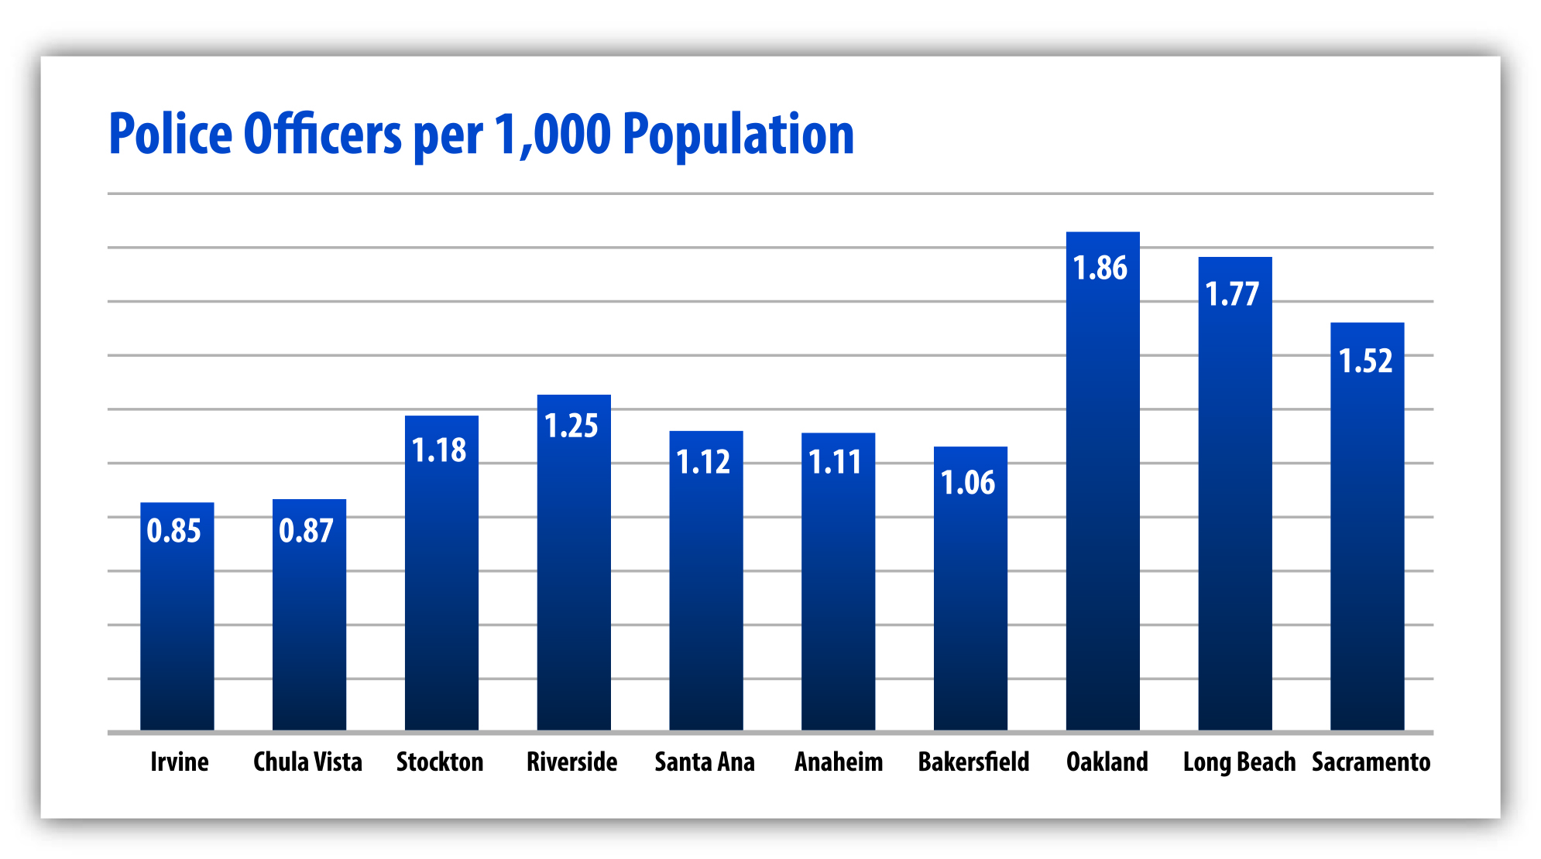
How Does CVPD Compare Regionally?
CHULA VISTA PUBLIC SAFETY

Slide 5
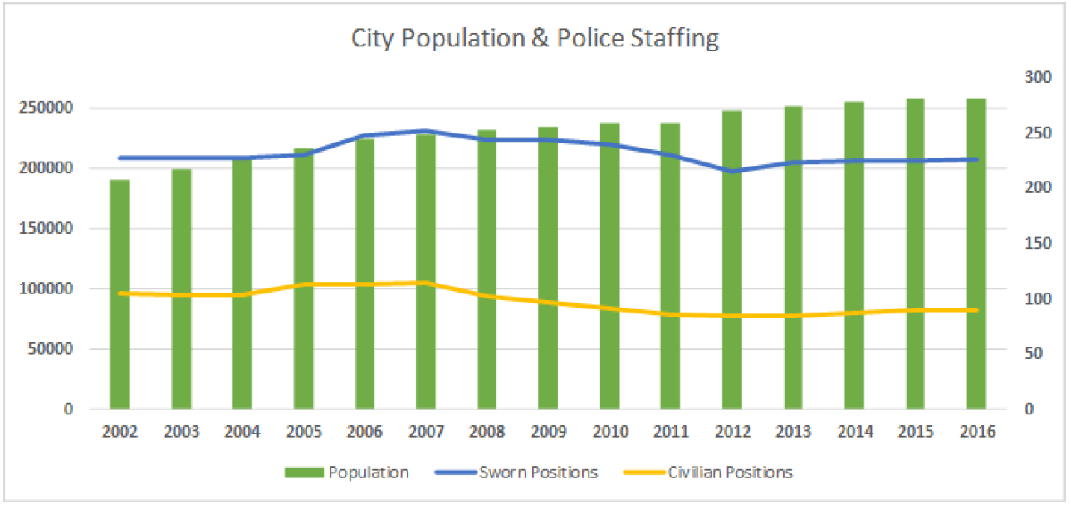
Great Recession continues to take its toll
.87
1.12
2007= 259 Sworn Officers. Officers per 1,000 population ratio: 1.12
2017= 232 Sworn Officers. Officers per 1,000 population ratio: .87
CHULA VISTA PUBLIC SAFETY

Slide 6
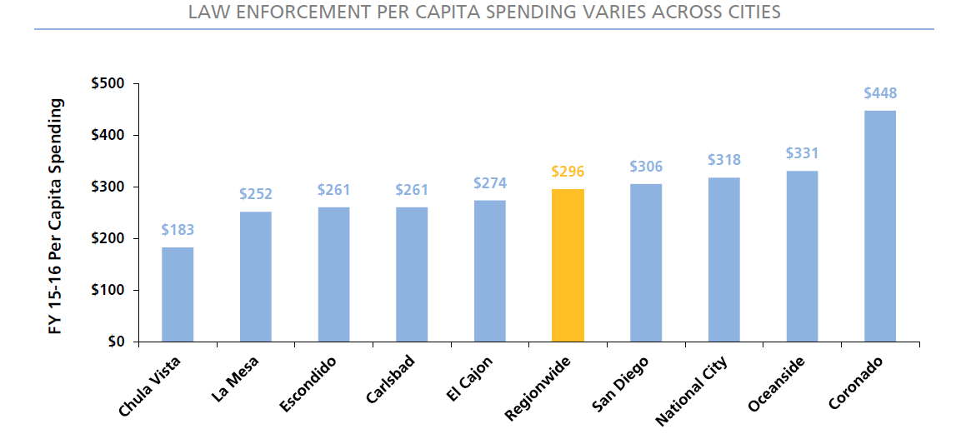
How does CVPD compare regionally?
Chula Vista spends $183 per capita on Law Enforcement
27.3% less than the next lowest, La Mesa of $252 per capita
38.1% less than the Regional average of $296 per capita
CVPD budget would need to be $67.4M to be tied for last in the county in per capita funding ($14M gap)
Source: SANDAG
CHULA VISTA PUBLIC SAFETY

Slide 7
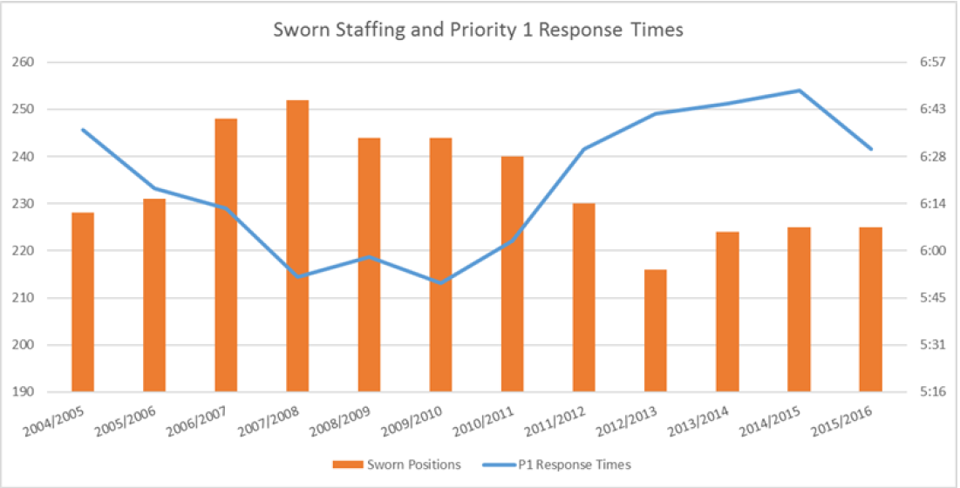
1.12
.87
CHULA VISTA PUBLIC SAFETY

Slide 8
Phase I & II Staffing Plan - Police
Positions | Phase I | Phase II | Total
Peace Officers | 16 | 11 | 27
Police Agents | 8 | 2 | 10
Police Sergeants | 5 | 1 | 6
Total Sworn | 29 | 14 | 43
Civilian Background Investigator | 2 | − | 2
Community Services Officer | 2 | 1 | 3
Detention Facilities Manager | 1 | − | 1
Police Comm Systems Manager | 1 | − | 1
Police Dispatcher | 7 | 4 | 11
Sr. Police Technology Specialist | 1 | − | 1
Total Non-Sworn | 14 | 5 | 19
Total Police Personnel | 43 | 19 | 62
CHULA VISTA PUBLIC SAFETY

Slide 9
Staffing Based on Half Cent Sales Tax
Enhanced patrols by adding 16 sworn positions
50% increase in School Resource Officers by adding 5 sworn positions
55% increase in Traffic Safety by adding 5 sworn positions
26% increase in Dispatch/9-1-1 by adding 7 dispatchers
CHULA VISTA PUBLIC SAFETY

Slide 10
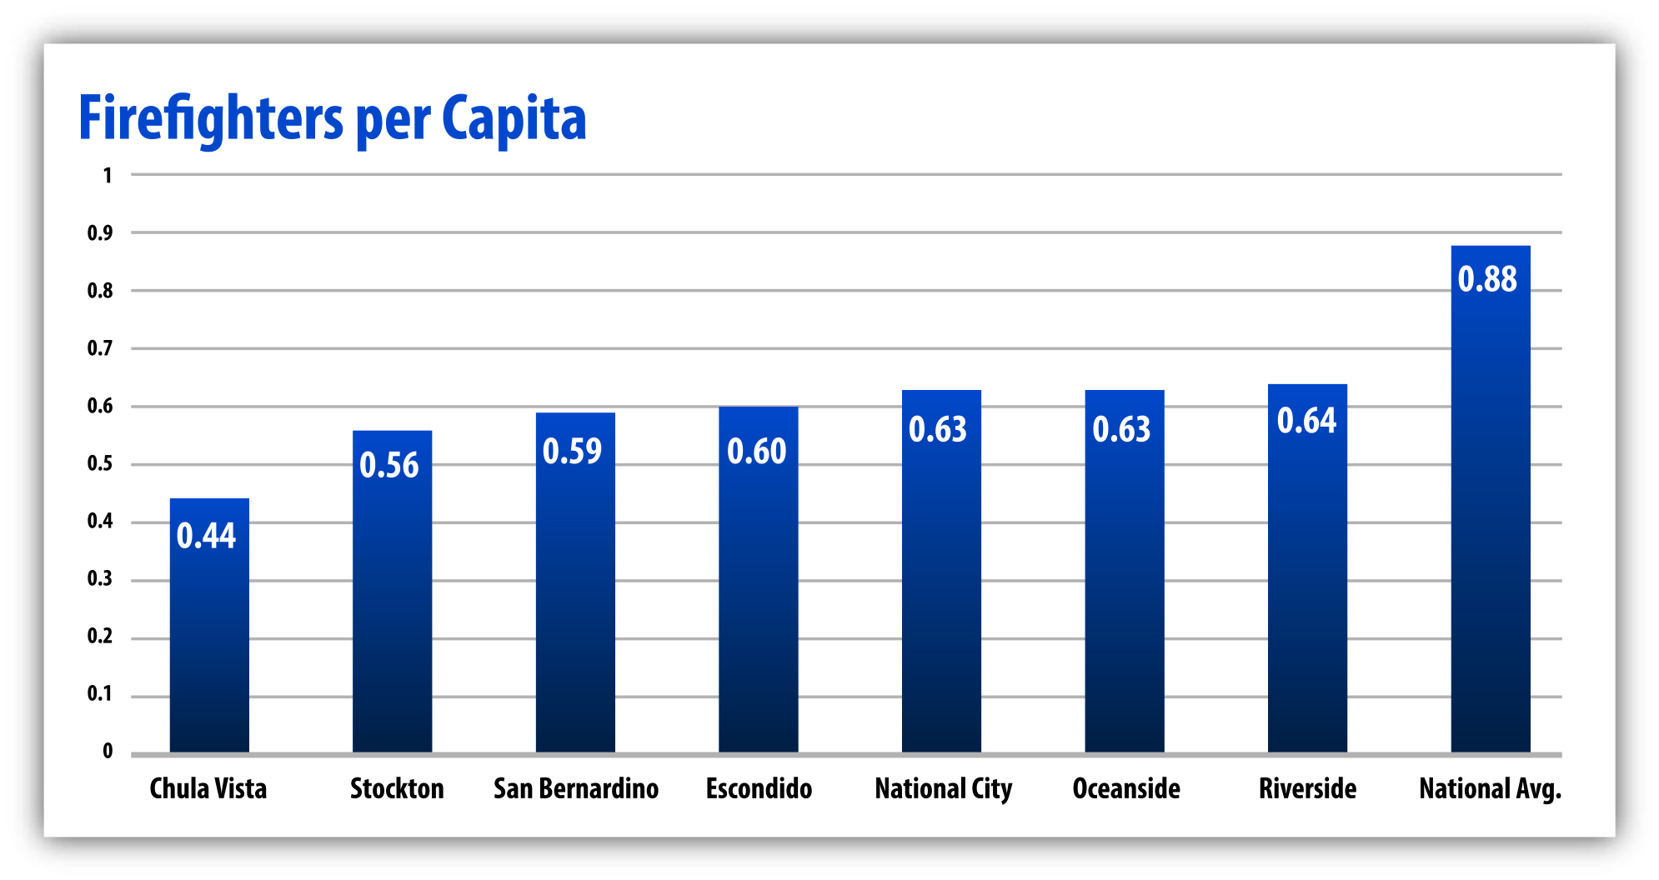
Fire Department – How We Compare
CHULA VISTA PUBLIC SAFETY

Slide 11
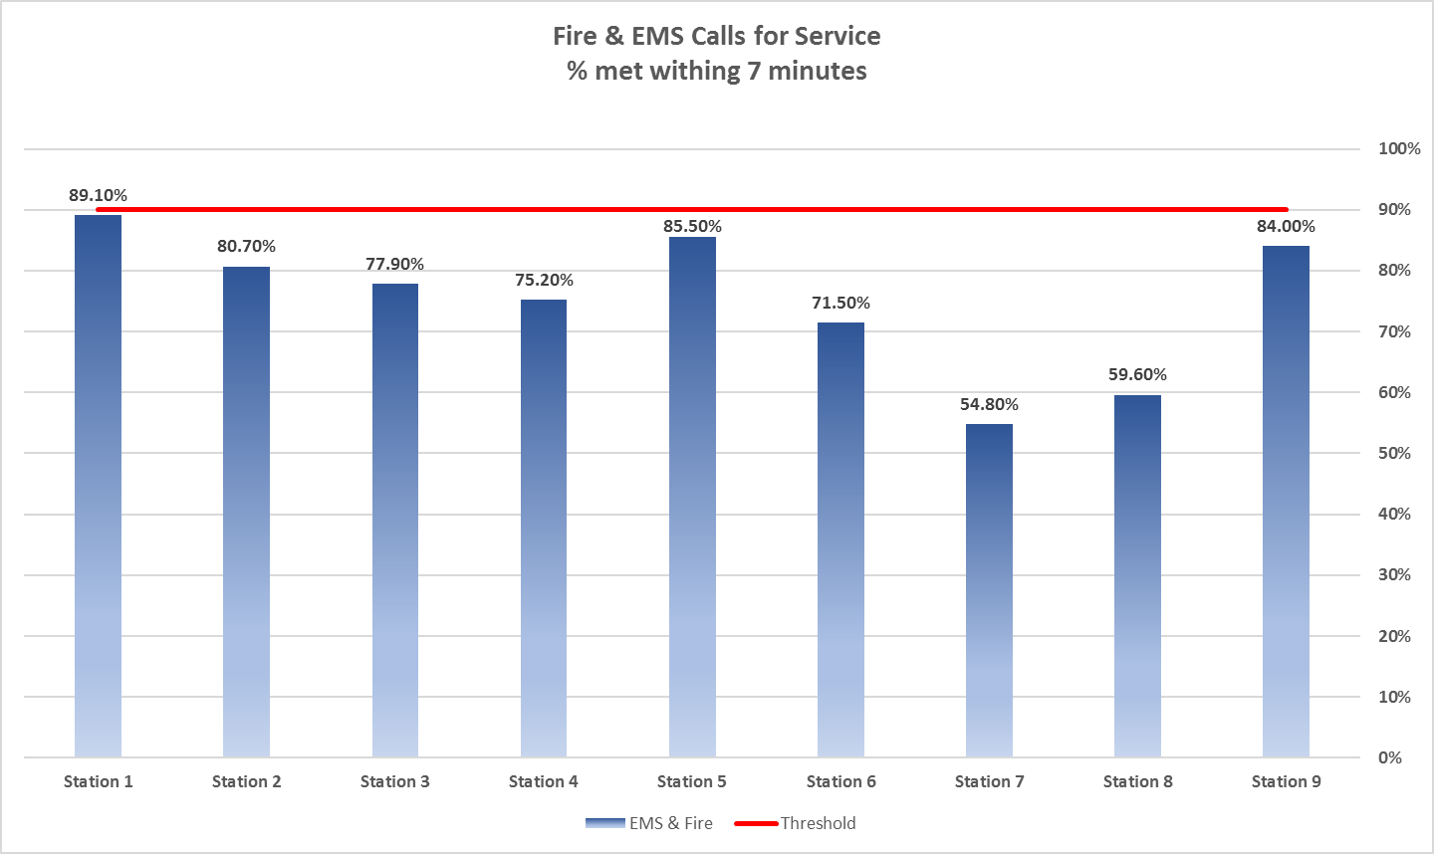
Fire Department – Response Time Performance
CHULA VISTA PUBLIC SAFETY

Slide 12
Phase I & II Staffing Plan- Fire
CHULA VISTA PUBLIC SAFETY

Slide 13
Staffing Based on Half Cent Sales Tax
Establish four squad companies for medical calls
Add a Fire Prevention Specialist
Staff the 4th Firefighter at the Millenia & Bayfront Fire Stations
Establish 4.0 staffing on (4) Engines
(1) Deputy Chief
CHULA VISTA PUBLIC SAFETY

Slide 14
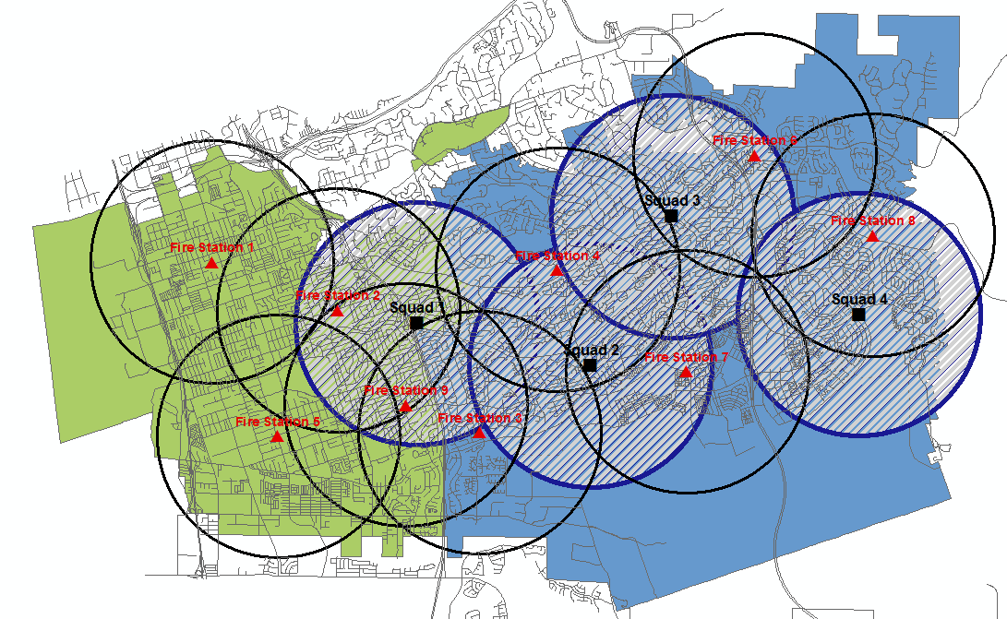
Coverage with Four Response Squads
Proposed Firefighters: 16
CHULA VISTA PUBLIC SAFETY

Slide 15
Reports and other information at www.chulavistaca.gov/publicsafety
CHULA VISTA PUBLIC SAFETY

Slide 16
Questions
CHULA VISTA PUBLIC SAFETY

