Slide 1
June 1, 2022 - January 31, 2024
Total Rides | 30,396
Total Riders | 35,649
Average Wait Time | 8:49
Vehicle Miles Traveled (VMTs) | 59,035 miles
Gallons of Gas Saved | 3,731
Greenhouse Gas (GHG) Emissions Saved | 33.17 metric tons
ADA Rides (2023) | 1,159
7.4 passenger vehicles driven for 1 year
6.5 homes electricity use for 1 year
548 tree seedlings grown for 10 years
Notes:
https://docs.google.com/spreadsheets/d/1Dt2qkqi59XJonaPT37VQnhTdAM2H-_Tdt-Gu9bliUrM/edit#gid=59605779

Slide 2
January 2024
Total Rides | 2,169
Total Riders | 2,464
Average Wait Time | 10:05
Vehicle Miles Traveled (VMTs) | 4,080 miles
Gallons of Gas Saved | 258
Greenhouse Gas (GHG) Emissions Saved | 2.29 metric tons
ADA Rides | 52
Notes:
https://docs.google.com/spreadsheets/d/1Dt2qkqi59XJonaPT37VQnhTdAM2H-_Tdt-Gu9bliUrM/edit#gid=59605779

Slide 3
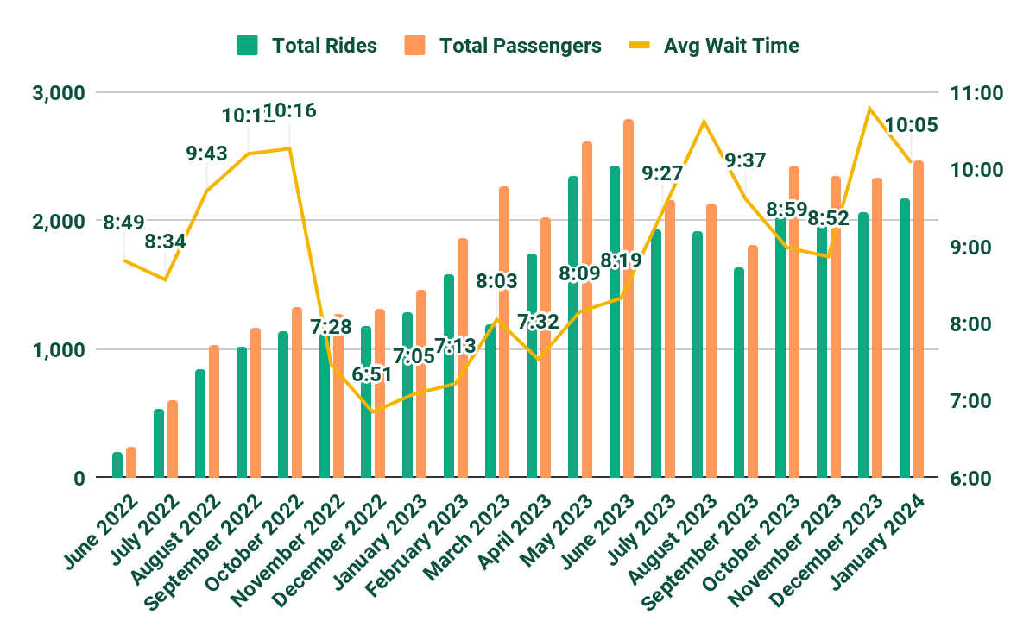
June 1, 2022 - January 31, 2024

