Slide 1
June 1, 2022 - March 31, 2024
Total Rides | 35,799
Total Riders | 40,925
Average Wait Time | 9:22
Vehicle Miles Traveled (VMTs) | 67,771.80 miles
Gallons of Gas Saved | 4,282.90
Greenhouse Gas (GHG) Emissions Saved | 38.01 metric tons
ADA Rides | 1,289
9.1 passenger vehicles driven for 1 year
7.5 homes electricity use for 1 year
629 tree seedlings grown for 10 years
Notes:
https://docs.google.com/spreadsheets/d/1Dt2qkqi59XJonaPT37VQnhTdAM2H-_Tdt-Gu9bliUrM/edit#gid=59605779

Slide 2
March 2024
Total Rides | 2,477
Total Riders | 2,823
Average Wait Time | 10:58
Vehicle Miles Traveled (VMTs) | 4,674 miles
Gallons of Gas Saved | 295.4
Greenhouse Gas (GHG) Emissions Saved | 2.63 metric tons
ADA Rides | 72
Notes:
https://docs.google.com/spreadsheets/d/1Dt2qkqi59XJonaPT37VQnhTdAM2H-_Tdt-Gu9bliUrM/edit#gid=59605779

Slide 3
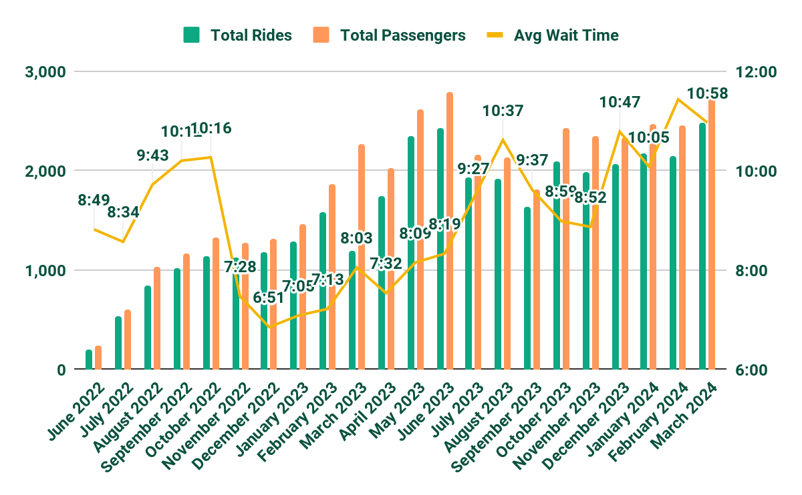
June 1, 2022 - March 31, 2024

